Slide 1

Oxford University Press – possibilities for academic teachers and researchers
Marcin Dembowski– marcin.dembowski@oup.com
March 2016
Tomsk

Slide 2

Agenda
University of Oxford - scholarships
About OUP
Current Subscribtion
Adittional resources supporting teaching
EPIGEUM

Slide 3

The University of Oxford
Overview
The oldest university in the English speaking world.
It is a collegiate research based institution.
Notes:
The University is made up of a variety of institutions, including 38 constituent colleges and a full range of academic departments which are organised into four Divisions. All the colleges are self-governing institutions as part of the University, each controlling its own membership and with its own internal structure and activities.

Slide 4
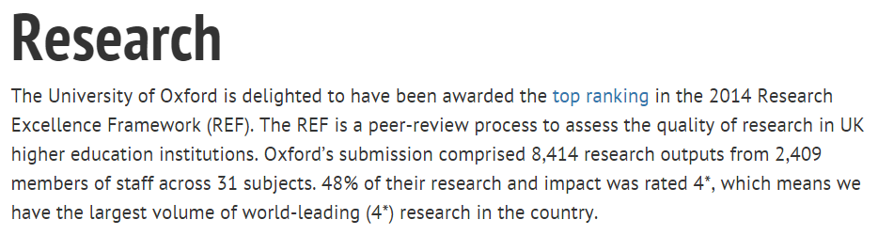

Oxford University and Research
Where does it rank?
Notes:
Result table - http://www.ox.ac.uk/research/research-impact/ref-2014-results/results-table
Summary of the results - http://www.ox.ac.uk/research/research-impact/ref-2014-results

Slide 5

Scholarships at Oxford University
Graduate Scholarships
University Wide Scholarships
College Scholarships
Department Scholarships
External
Scholarships
Notes:
http://www.ox.ac.uk/admissions/graduate/fees-and-funding/graduate-scholarships/external-scholarships
These scholarships are generally fully-funded, covering all your fees and living expenses, although some awards are smaller. Most have eligibility restrictions, for example, based on your country of ordinary residency or your course of study. The vast majority are only open to candidates who are applying to start a new graduate course of study.
To be eligible for consideration for the majority of these scholarships, applicants must be successful in being offered a place on their course after consideration of applications received by the relevant January deadline for their course.

Slide 6

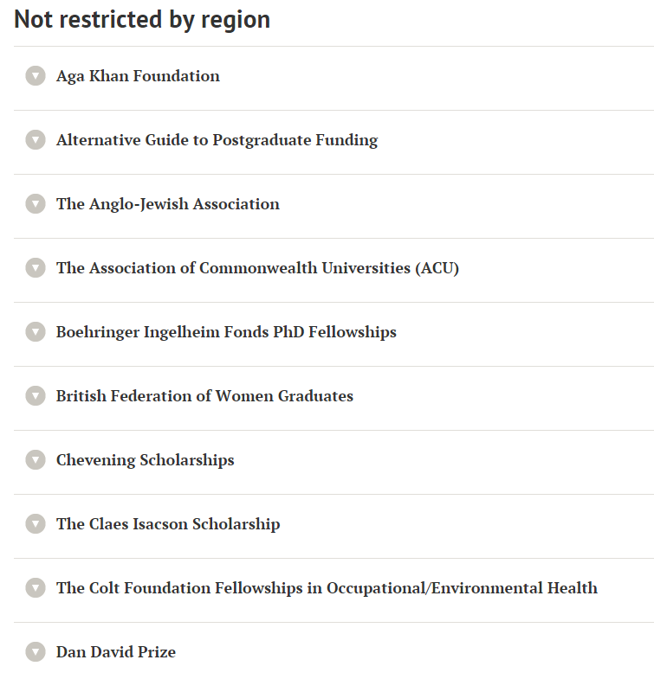
External Scholarships
Not Restricted by Region
Notes:
http://www.ox.ac.uk/admissions/graduate/fees-and-funding/graduate-scholarships/external-scholarships
29 different scholarships
Awarded by external bodies
Relevant to

Slide 7

External Scholarships
Not Restricted by Region
29 different scholarships awarded by external bodies.
http://www.ox.ac.uk/admissions/graduate/fees-and-funding/graduate-scholarships/external-scholarships
Notes:
http://www.ox.ac.uk/admissions/graduate/fees-and-funding/graduate-scholarships/external-scholarships
29 different scholarships
Awarded by external bodies
In different fields of studies and from different countries of the world

Slide 8
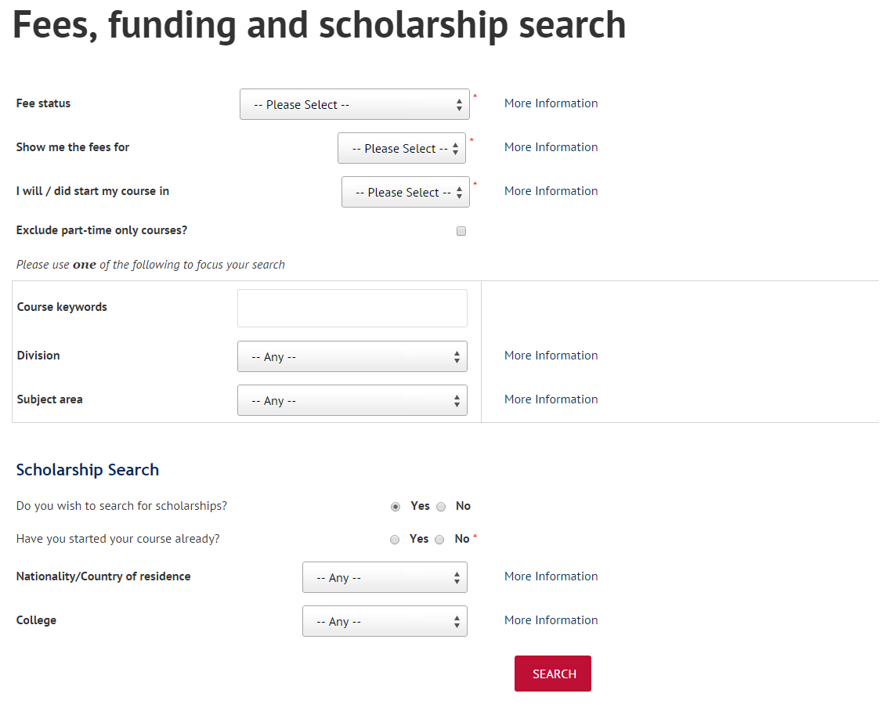
Scholarships
Tools to search for relevant scholarship
http://www.ox.ac.uk/admissions/graduate/fees-and-funding/fees-funding-and-scholarship-search/search
Notes:
Fees, funding and scholarship search: http://www.ox.ac.uk/admissions/graduate/fees-and-funding/fees-funding-and-scholarship-search/search
This tool offers you the ability to look for relevant scholarships in the field of your interest.

Slide 9

Grants
http://www.ox.ac.uk/research/support-researchers
Support for Researchers
Notes:
This portal offers help and assistance for researchers seeking grants: http://www.ox.ac.uk/research/support-researchers

Slide 10
Oxford University Press

Slide 11

Oxford University Press (OUP)
Our mission
Oxford University Press is a department of the University of Oxford. It furthers the University's objective of excellence in research, scholarship, and education by publishing worldwide.
John Fell
Clarendon Presentation—Tim Barton (November 2011)
Notes:
Emphasise we publish within the university’s mission: “Excellence in Research and Scholarship”.

Slide 12


A Very Short Introduction
Origins date back to 1478
Largest university press
25th largest publisher in the world
6,000 employees worldwide
Over 5,000 titles per year, and 300 journals
Notes:
With origins dating back to 1478, when first book published at university
OUP is among the oldest university presses in the world
Picture of the delegates meeting in Clarendon building, where continuously meeting since 18th century.
Picture of the Press’s main office in Oxford
It is also the largest university press in the world
In fact, OUP is bigger than all other English language university presses in the world put together
Including the 110 UPs in the US, PLUS Cambridge.
Employ 6,000 people worldwide with major publishing offices in Oxford, New York, and Dehli.
Publish close to 7,000 new titles each year, 300 journals, and a range of online products.
Publish in more than 40 languages, and in a variety of formats– print and digital.
Sell more than 110 million units each year, and most of those sales are outside of the UK.
OUP accounts for 55% of the University Press market.
While giant by university press standards, we are a mid-sized publisher within the wider industry.
According to a global ranking of the Publishing industry, we’re the 25th largest.
About $1 billion in sales per year.

Slide 13










Our publishing areas…
Global Academic
English Language Training
International Education
Notes:
One press, but made up of 3 distinct publishing units.
Academic unit:
Dictionaries (including OED)
Journals program
Research monographs
Subject Reference
English Language Training
Textbooks used in teaching English
Range of print and digital offerings used worldwide
Education
Student teaching tools
Print textbooks and online products
Used worldwide, for teaching in English
Local language material produced in branch offices

Slide 14
Oxford University Press
Products

Slide 15
Support to Students Researchers and Academics
Reference Materials
ODO, OBO, ORO
Framing the question for exploration & reflection
Scholarly Resources
OHO, UPSO, Journals, Research Encyclopaedias
Build argument & Support with evidence
Topic
Oxford Index
Generating related OUP content to deepen your search
Notes:
Linking our material to a research journey where each of them falls under one category.
The reference material would be: ODO, OBO, ORO
The Scholarly Resources: OHO, UPSO, Journals
The subject specific will vary between reference and scholarly resources because they cover both aspects based on their content.

Slide 16








Each resource provides a vital step on the research journey, from quick fact checking, to reviewing the literature in a field, to keeping up to date with the latest research.
Where do OUP Resources Fit in your Research Journey?
Subject Specific Resources
Notes:
The following slides show how each resource fits into the research journey. Each resource provides a vital step on the research journey, from quick fact checking, to reviewing the literature in a field, to keeping up to date with the latest research.

Slide 17
TGU current subscribtion

Slide 18
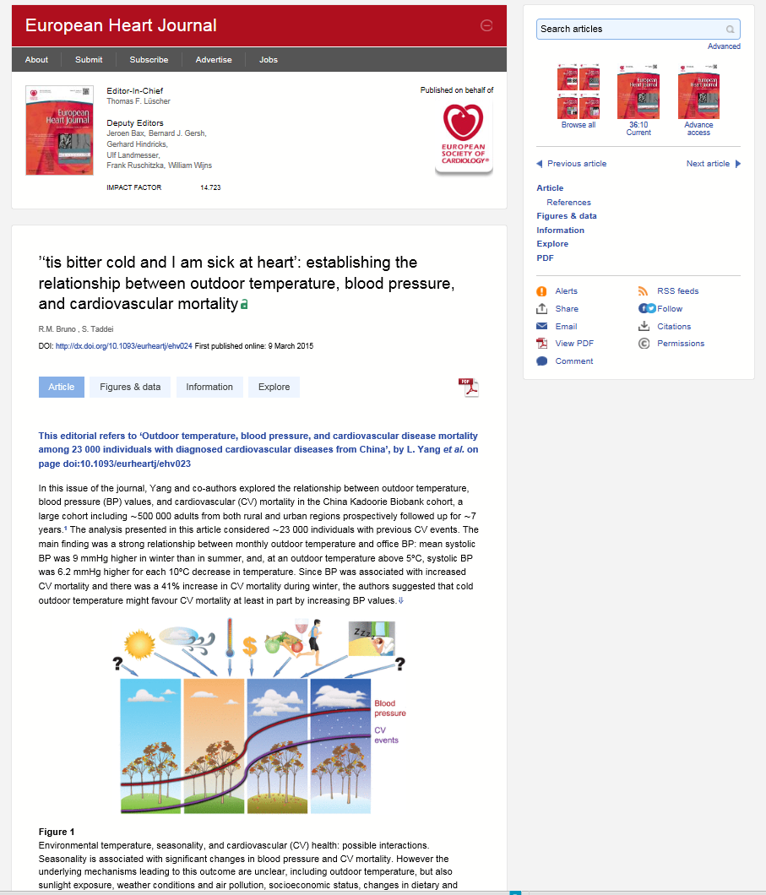
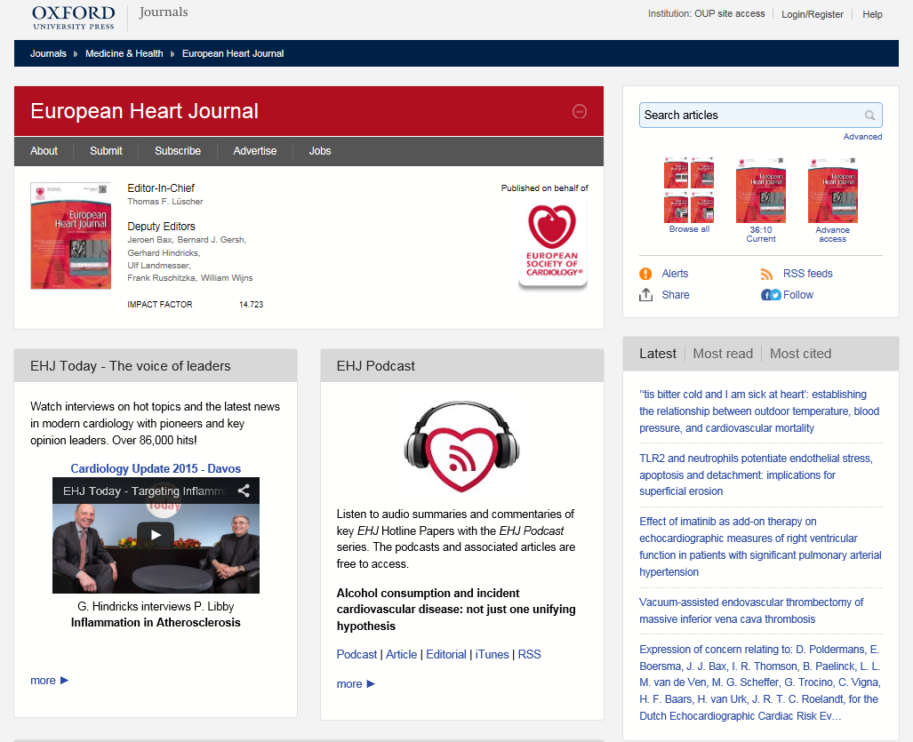
Oxford Journals Online
Transitioning to the new site
Notes:
6 subject areas
New feel, more user friendly
Things to highlight – downloading images to powerpoint or as an image. Links to library catalogue. Extensive alerting to keep the researcher up-to-date re the author’s publications and new articles in a search field, etc.

Slide 19
OUP Journal Joiners
Publishing partnerships
We consider our role in the academic community to extend to the publishing we do on behalf of societies
We publish over 300 journals in law, medicine, the humanities, social sciences, life sciences, and mathematics and physical sciences – two-thirds of which are published in partnership with learned and professional societies
Societies want to publish with OUP because we understand and can deliver on shared strategic goals for their titles

Slide 20
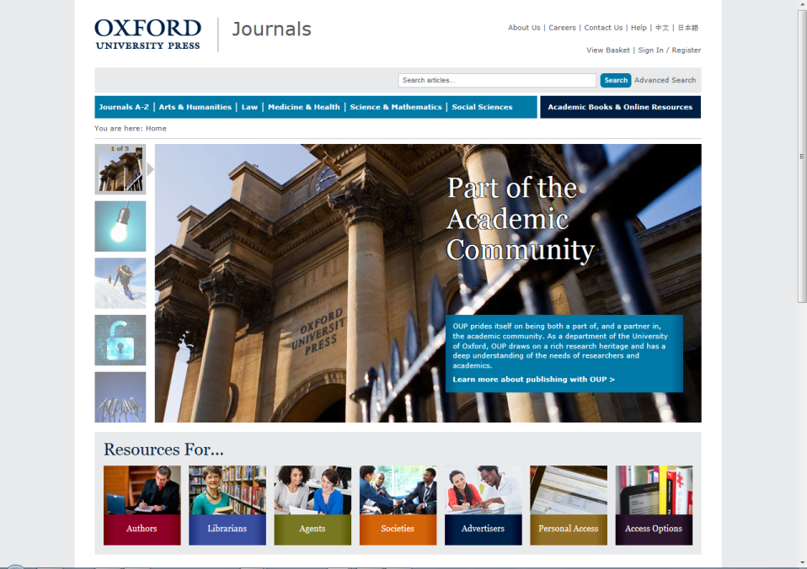
Oxford University Press (OUP) publishes the highest quality journals and delivers this research to the widest possible audience.
We achieve this by working closely with our society partners, authors, and subscribers in order to provide them with publishing services that support their research needs.
www.oxfordjournals.org

Slide 21
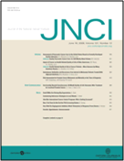
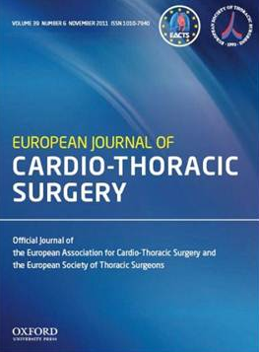

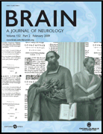



The Medicine Collection
  Oncology, cardiology, neurology, epidemiology, reproductive medicine, rheumatology, anesthesia, gerontology, & public health
The Life Sciences Collection
  Molecular and computational biology, plant science, marine biology, and behavioral ecology

Slide 22
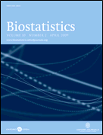



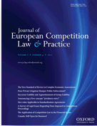

The Mathematical & Physical Sciences Collection
Pure and applied mathematics, radiation science
Also coverage of more niche areas such as biostatistics and mathematical physics, management, and medicine
The Law Collection
general academic and practitioner law titles, and those dedicated to more specialized areas such as medical & environmental law, criminology, intellectual property, & policing

Slide 23
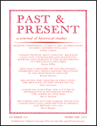
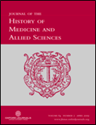
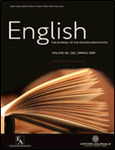
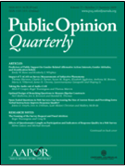


The Humanities Collection
  History, philosophy, literature, religion, art, and music
The Social Sciences Collection
  Economics, finance, business, global development, religion, and social politics

Slide 24
www.oxfordjournals.org

Slide 25
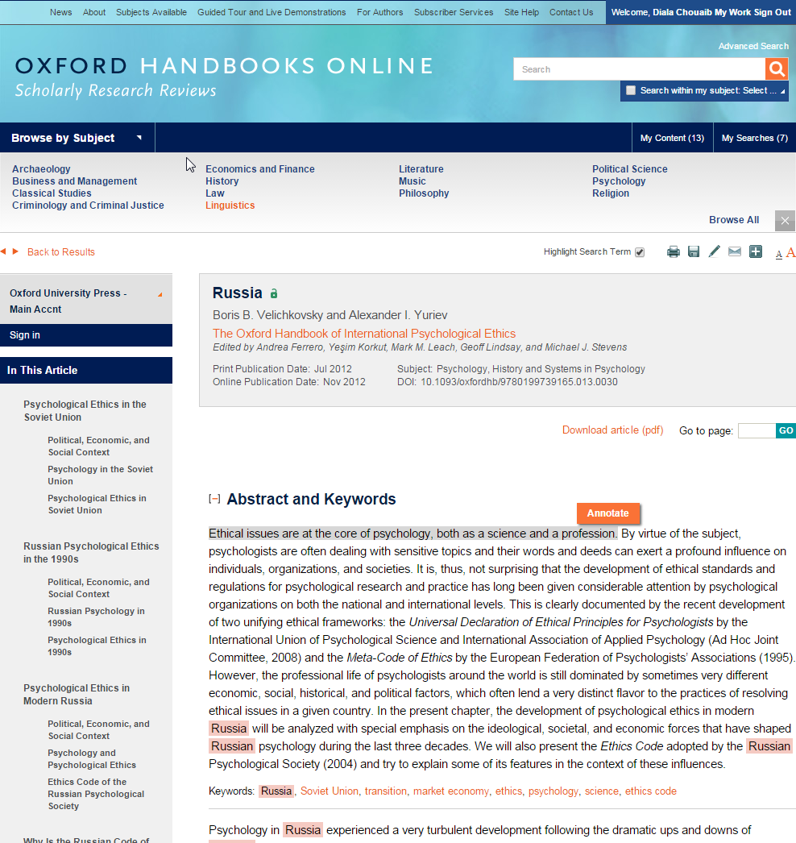
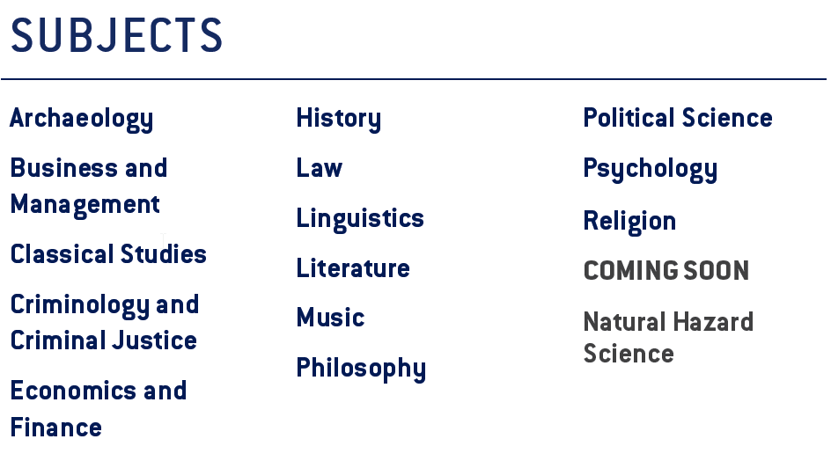

Oxford Handbooks Online
Explore the content
14 subject areas
Scholarly reviews of subjects in humanities and social sciences.
Articles are posted online as soon as they are ready. Extremely up to date
Notes:
14 subject areas
1- Scholarly reviews of subjects in humanities and social sciences.
2- Articles are posted online as soon as they are ready. Extremely up to date.
Points to highlight – annotate and existence of QR codes in printer friendly versions

Slide 26

Oxford Handbooks Online
Archaeology
Business & Management
Classics
Criminology
Economics & Finance
History
Law
Linguistics
Literature
Music
Philosophy
Political Science
Psychology
Religion
Over 17 000 Chapters

Slide 27













Editors in Chief and Editorial Boards
Chris Gosden Archaeology | Michael Hitt Business and Management | Michael Tonry Criminology and Criminal Justice | William Doyle History
Sally Thomason Linguistics | Colin Burrow Literature | Alexander Rehding Music | Sandy Goldberg Philosophy
Desmond King Political Science | Peter Nathan Psychology | Mark Juergensmeyer Religion | Markus Dubber Law
Gareth Williams
Classical Studies
Ensure accuracy, authority, and objectivity
Commissioning online-only peer reviewed articles
Expanding research in cutting edge topics
Ensuring comprehensive coverage of fast-moving disciplines

Slide 28
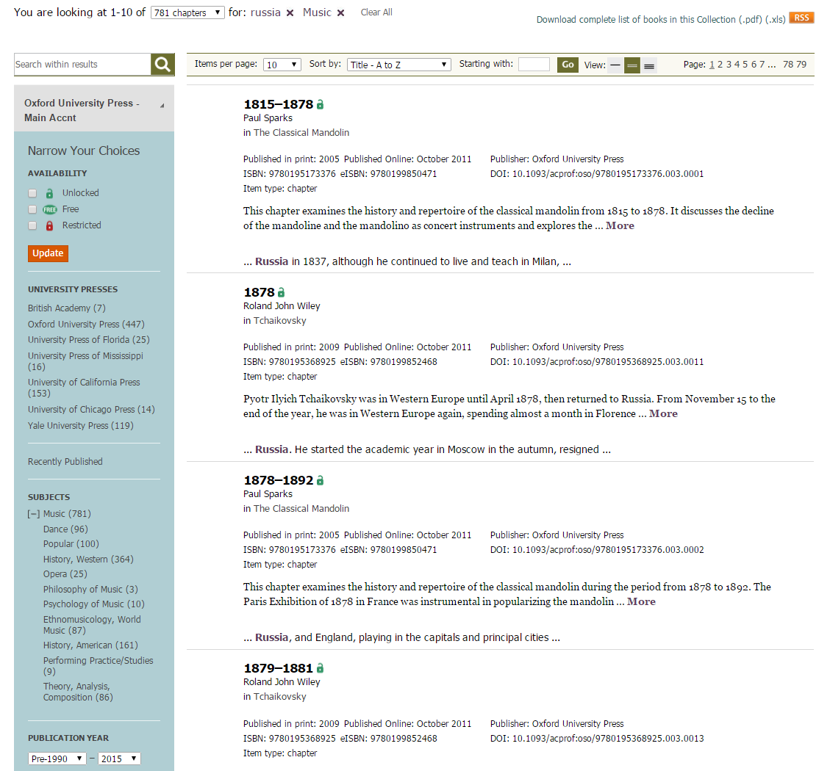
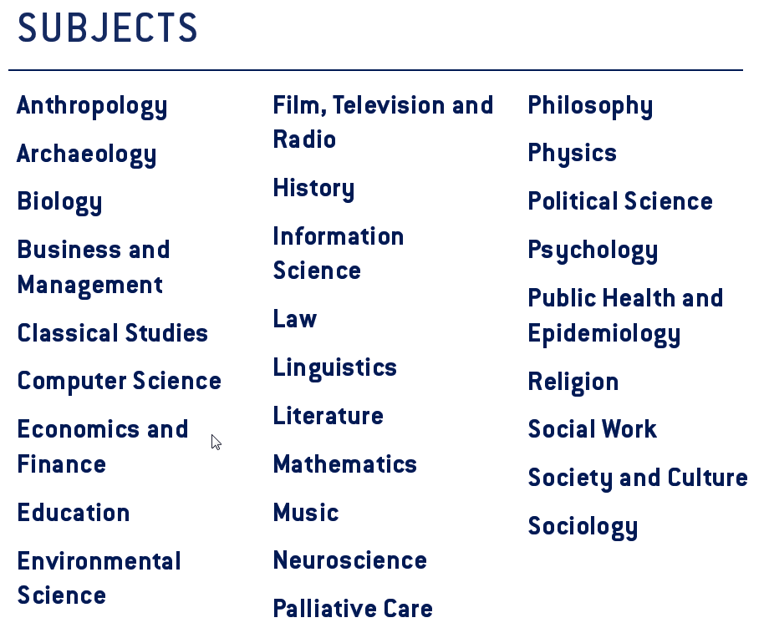
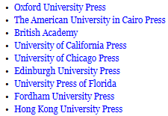
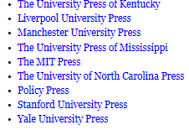
University Press Scholarship Online
Explore the content
Notes:
28 subject areas
1- Information across 18 partner presses as shows on the left column of the page.
2- Monographs

Slide 29


Presentation Outline
Oxford Scholarship Online
University Press Scholatship Online
Notes:
This presentation introduces the history of one of our flagship online products – Oxford Scholarship Online and uses it as a case study to take you behind the scenes when creating and digitising an online product, from the publisher perspective.
It also offers up three key challenges that we meet when digitizing our academic monographs.
There will be opportunity at the end of the presentation to reflect on the challenges and discuss the future of ebooks, but if you have any questions in the meantime, or you need me to explain anything further, or slow down, please do speak out.

Slide 30
Presentation Outline
Oxford Scholarship Online
University Press Scholatship Online
12,000 Books in 20 discilplines
19,000 Books in 29 discilplines
Notes:
This presentation introduces the history of one of our flagship online products – Oxford Scholarship Online and uses it as a case study to take you behind the scenes when creating and digitising an online product, from the publisher perspective.
It also offers up three key challenges that we meet when digitizing our academic monographs.
There will be opportunity at the end of the presentation to reflect on the challenges and discuss the future of ebooks, but if you have any questions in the meantime, or you need me to explain anything further, or slow down, please do speak out.

Slide 31
University Press Scholarship Online (UPSO)
Participating presses:
Oxford University Press The American University in Cairo Press
University of Chicago Press University of California Press
Edinburgh University Press University Press of Florida
Fordham University Press Hong Kong University Press
The University Press of Kentucky Manchester University Press
Policy Press The MIT Press
Stanford University Press

Slide 32
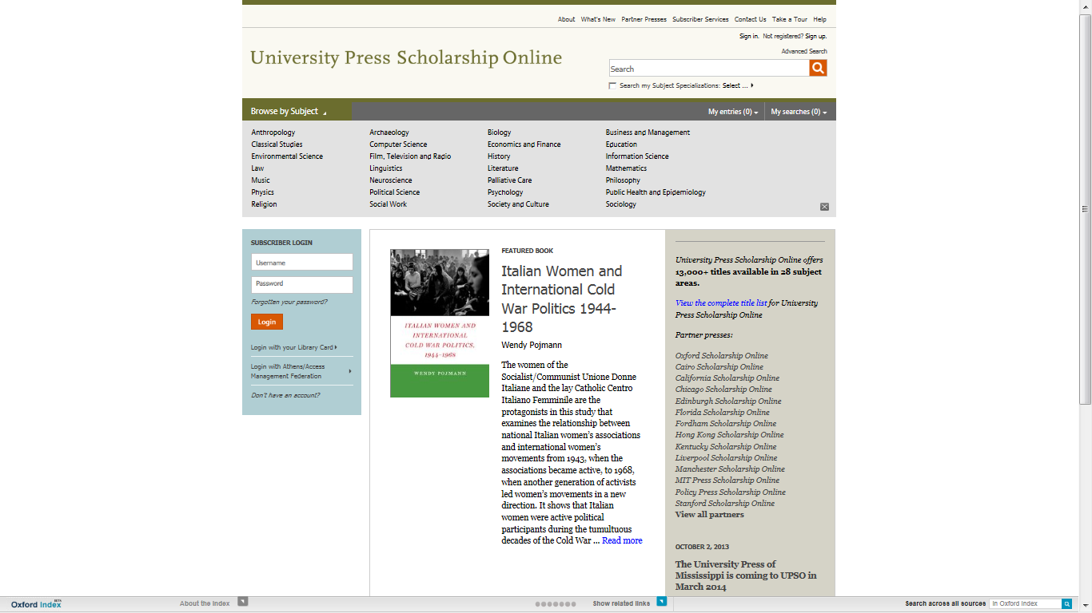

Slide 33
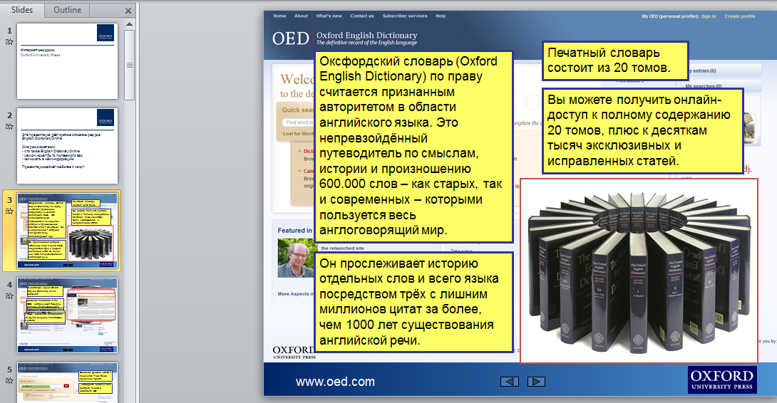

Slide 34
Current needs of Russian universities?

Slide 35
Teaching
Research
Academic Publishing

Slide 36
How other products and services from OUP can help to achieve it?

Slide 37

  The Information Overload Problem
  Difficult to keep up with developments in the field
  Labor-intensive to start research in unfamiliar areas
  Slows productivity on research projects
  Guiding students is major challenge.

Slide 38

Mobilizing the community of experts

Slide 39

Global network of research

Slide 40
Subject Specific Resources
Examples
Subject Specific Resource
Oxford Legal Resources
Notes:
Other subject specific resources can be:
1- Legal Resources
2- Medicine
3- Research Encyclopedias.

Slide 41

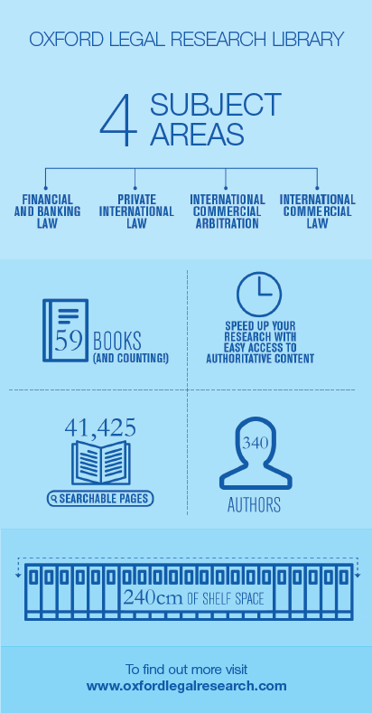
Support to Practitioners in their Fields
OUP in Law
Notes:
We have resources which cover different legal fields including: international commercial law, financial law, private international law, international commercial arbitration in the Oxford Legal Research Library.
You will find in the content – journals, cases, instruments, monographs, analysis, etc.

Slide 42
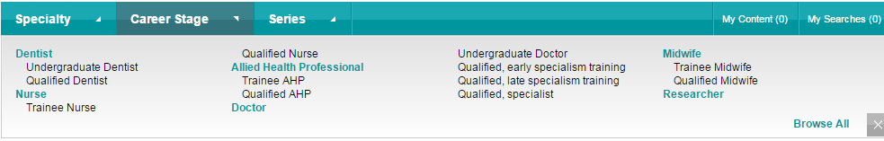




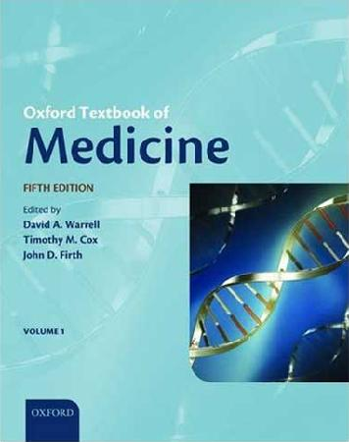



Support to Researchers and Students in their Fields
OUP in Medicine
Notes:
85 specialties and sub-specialties

Slide 43

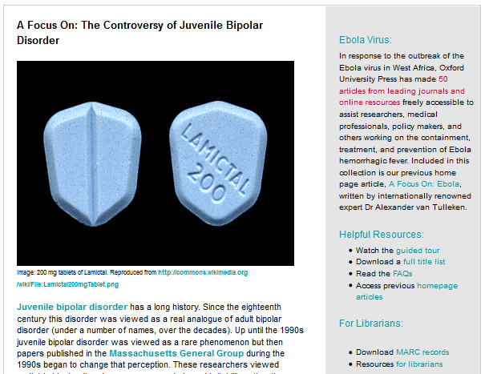
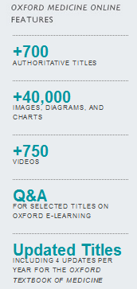

Slide 44
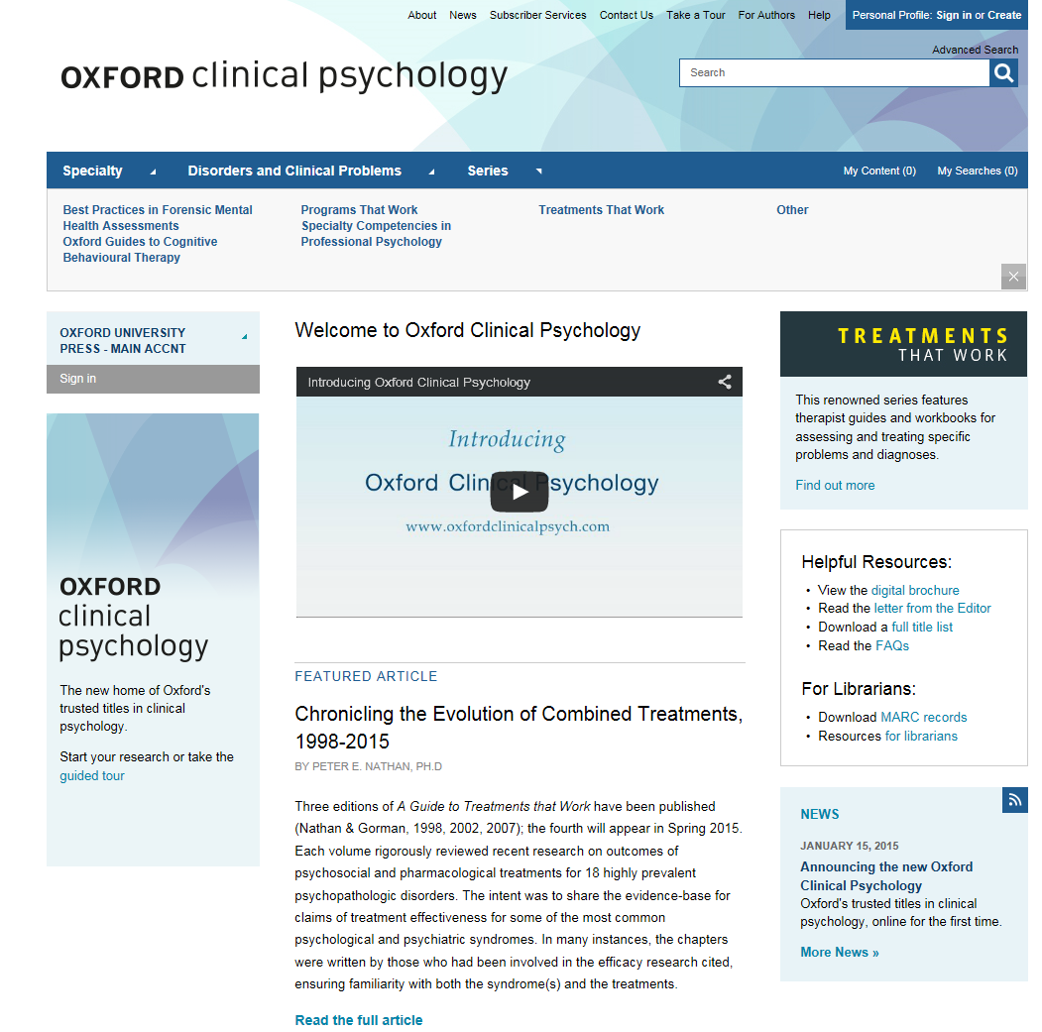

Slide 45

The User Journey
Reference, biography, and dictionaries
From quickly checking a fact or definition to researching a term, concept, or person in-depth, with articles and essays
Very Short Introductions
Discover an intelligent and serious introduction to a topic or subject, written by experts in the field that make often challenging topics highly readable
All connected by the Oxford Index
One search brings together top quality content and unlocks connections in a way not previously possible.
Handbooks
Read in-depth, high-level articles by scholars at the top of their field, with each handbook creating an original conception of the field and setting the agenda for new research
Academic monographs
Research-level scholarship providing a written study of a single specialized subject, or an aspect of it

Slide 46




Presentation Outline
Online Dictionaries

Slide 47
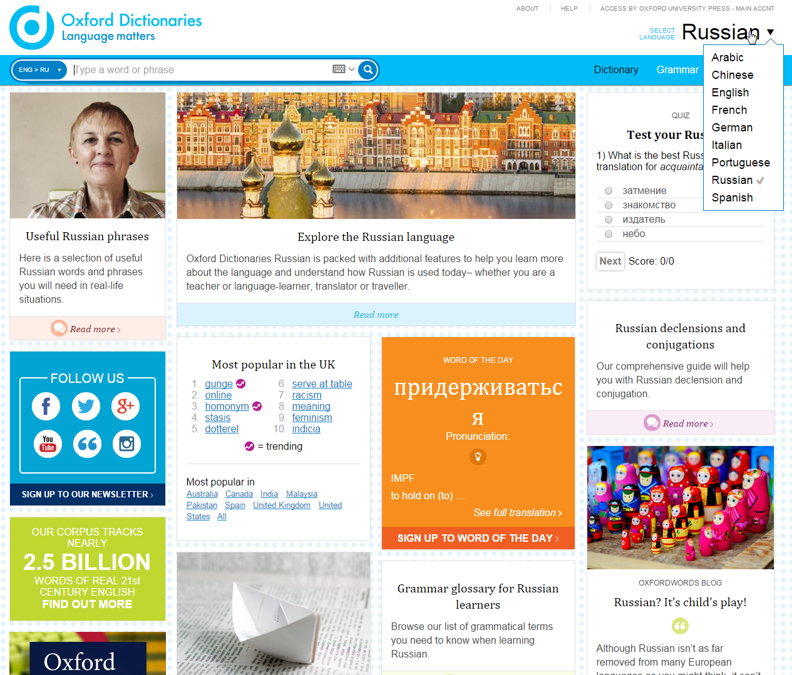
Oxford Dictionaries
If you are learning English as a second
language or wish to expand your
knowledge in Russian, you will be able
to:
*Look at the Explore section to learn more
about writing, the holidays of the country
*You will be able to hear the pronunciation of
words and sentences
*You will be able to transliterate i.e.
type Arabic with Latin characters and the
dictionary recognises the Arabic equivalent
The dictionary re-launched with adding
Russian and Chinese to its content
The introduction of Portuguese as a new
joiner to the site
The increase of the information and
definition within the French, Spanish,
Italian, and German languages
Explore the content
Notes:
1- The dictionary relaunched a week back with adding Russian, Chinese to its content
2- The introduction of Portuguese as a new joiner to the site
3- The increase of the information and definition within the French, Spanish, Italian, and German languages
4- If you are learning English as a second language or wish to expand your knowledge in Russian, you will be able to:
*Look at the Explore section to learn more about writing, the holidays of the country
5- You will be able to hear the pronunciation of words and sentences
6- You will be able to transliterate i.e. type Arabic with Latin characters and the dictionary recognises the Arabic equivalent

Slide 48
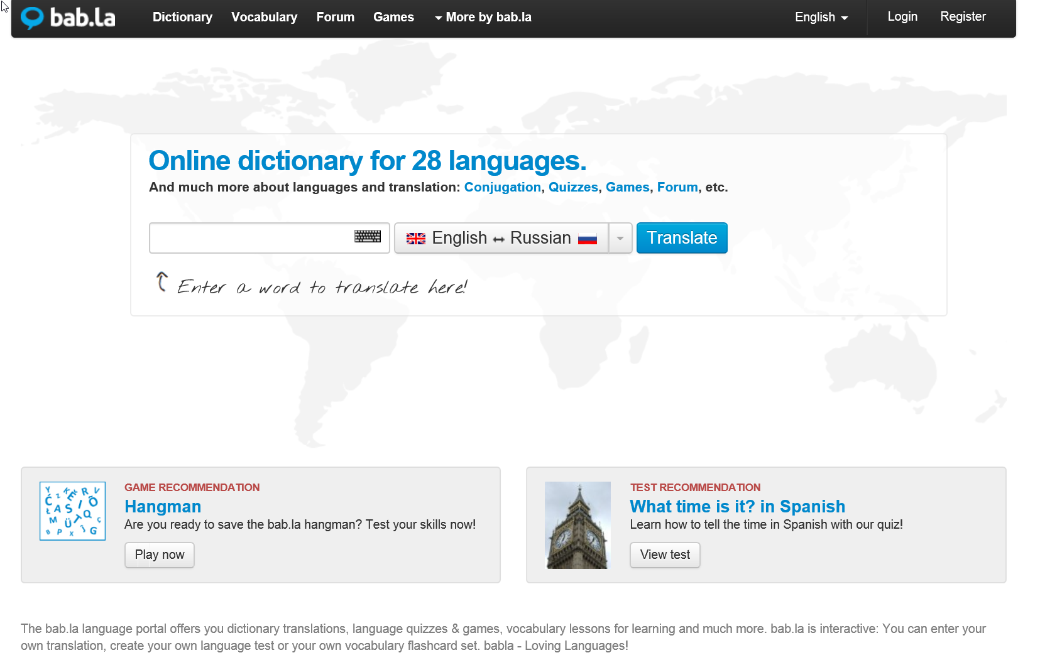

Slide 49
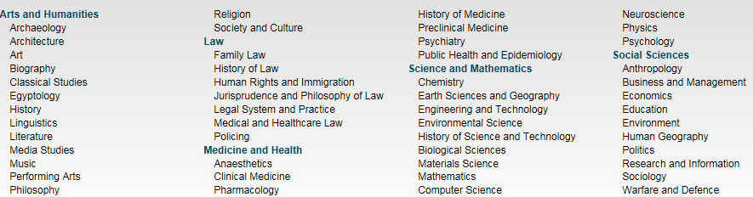
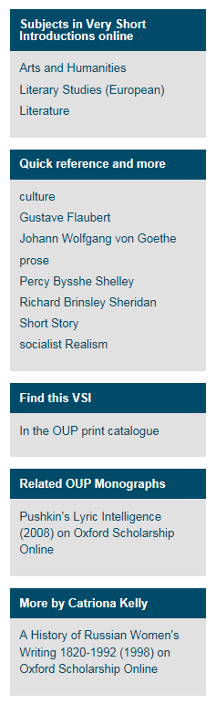
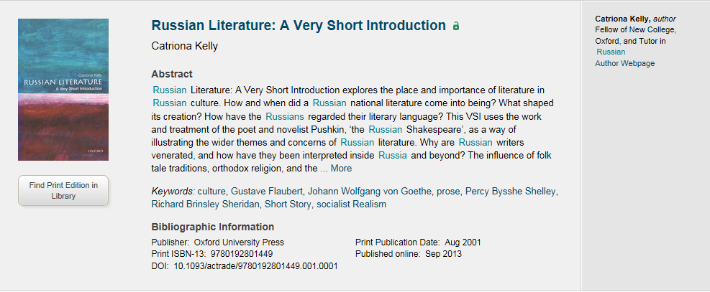
Very Short Introductions
VSI gives you an A-Z about any subject area with simple words to make the subject more approachable especially something like Quantum Physics.
Very Short Introductions offer concise introductions to a diverse range of subject areas
400+ books available
5 Subject Area with 50 different subtopics
Explore the content
The extra material (right of the slide) for every book – videos, blog posts, additional material from other resources (OSO and ORO), additional linking related to the topic or the author.
The author webpage and the ability to locate the physical book in one’s own library
Notes:
In the research journey, these fall within the references because it gives you an A-Z about any subject area with simple words to make the subject more approachable especially something like Quantum Physics.
Very Short Introductions offer concise introductions to a diverse range of subject areas
400+ books available
5 Subject Area with 50 different subtopics
Things to highlight –
The extra material (right of the slide) for every book – videos, blog posts, additional material from other resources (OSO and ORO), additional linking related to the topic or the author.
The author webpage and the ability to locate the physical book in one’s own library

Slide 50
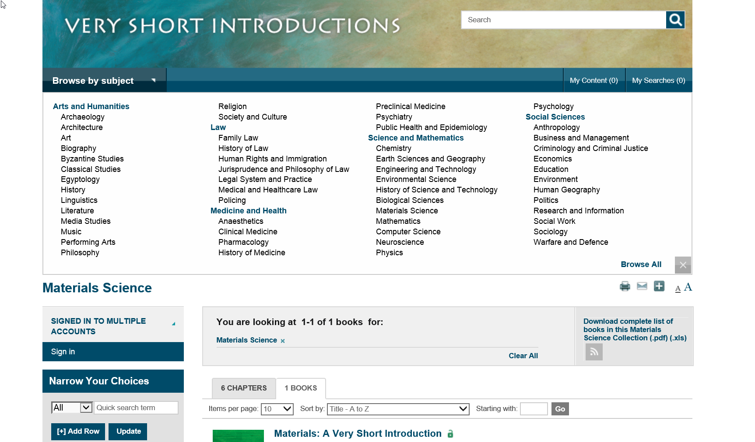

Slide 51
Oxford Bibliographies

Slide 52
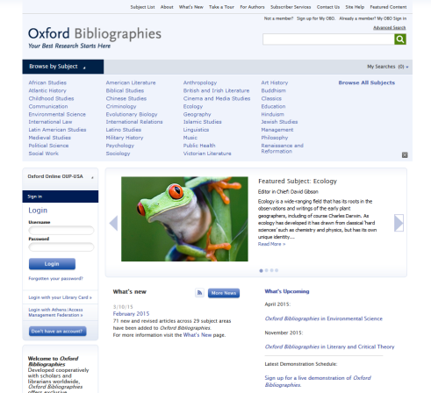
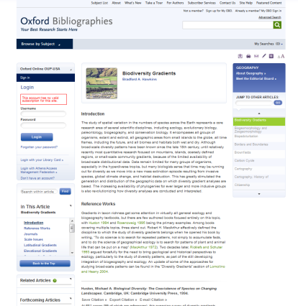
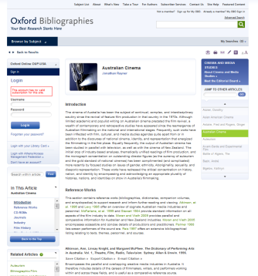
Oxford Bibliographies: What is it?
Guides research through growing mass of academic output
Reproduces the experience of asking an expert for recommendations
By invitation, only online, double peer-review
Helps researchers save time and increase productivity

Slide 53
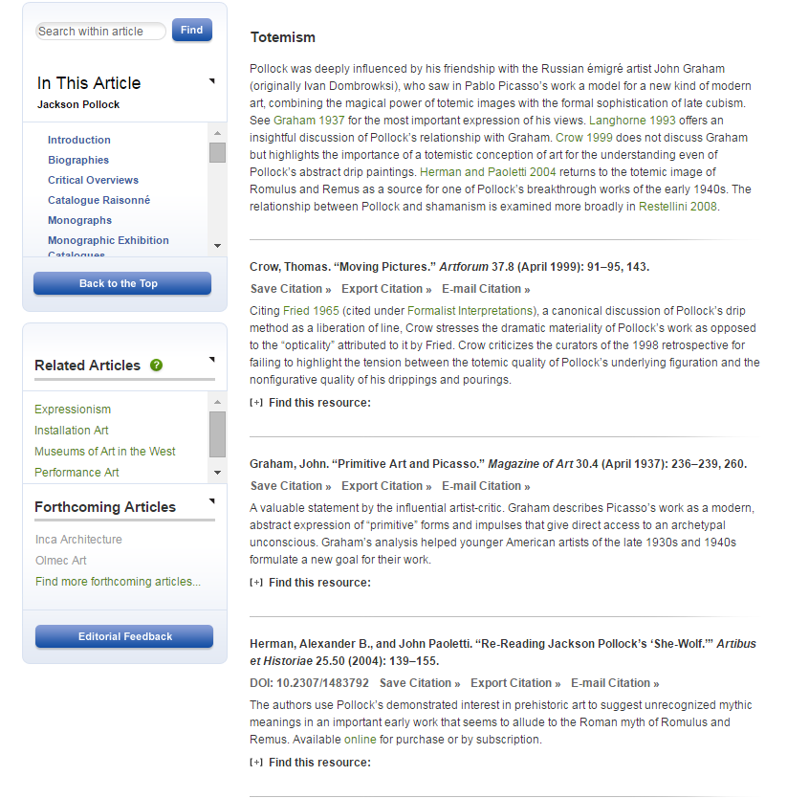
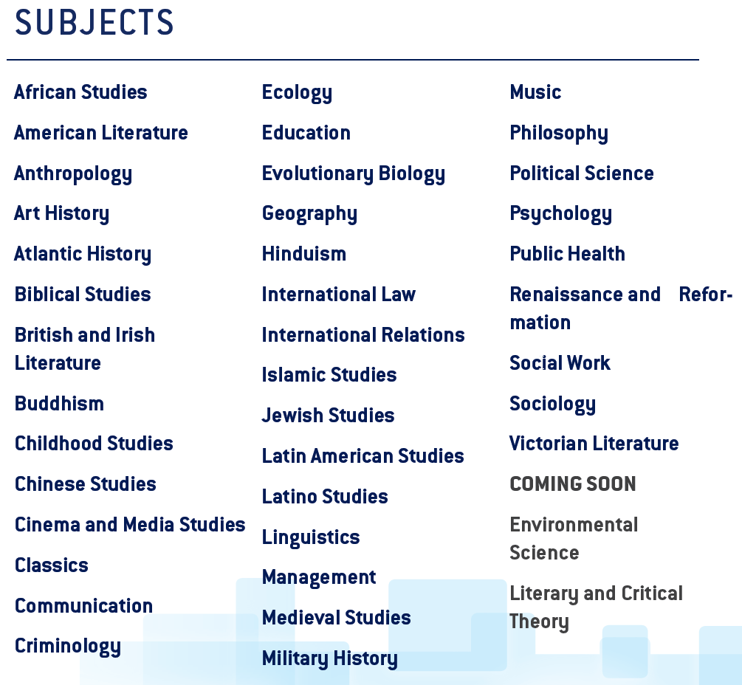
Oxford Bibliographies Online
If you wish to build your arguments and expand your topic with evidence from different publication houses, OBO will be able to help you look across 41 subject areas.
You will be able to identify key works across: monographs, different reference works, journals, etc.
Explore the content
Notes:
39 Subject Areas
Adding Environmental Science in April
Literary and Critical Theory
If you wish to build your arguments and expand your topic with evidence from different publication houses, OBO will be able to help you look across 39 subject areas.
You will be able to identify key works across: monographs, different reference works, journals, etc.
You can also link it to your library catalogue with the OpenURL to raise awareness of your library’s content while developing your research journey
Points to highlight – the ability of nominating PhD students to have their works included in OBO. It can be found in the editorial page of each subject area.

Slide 54
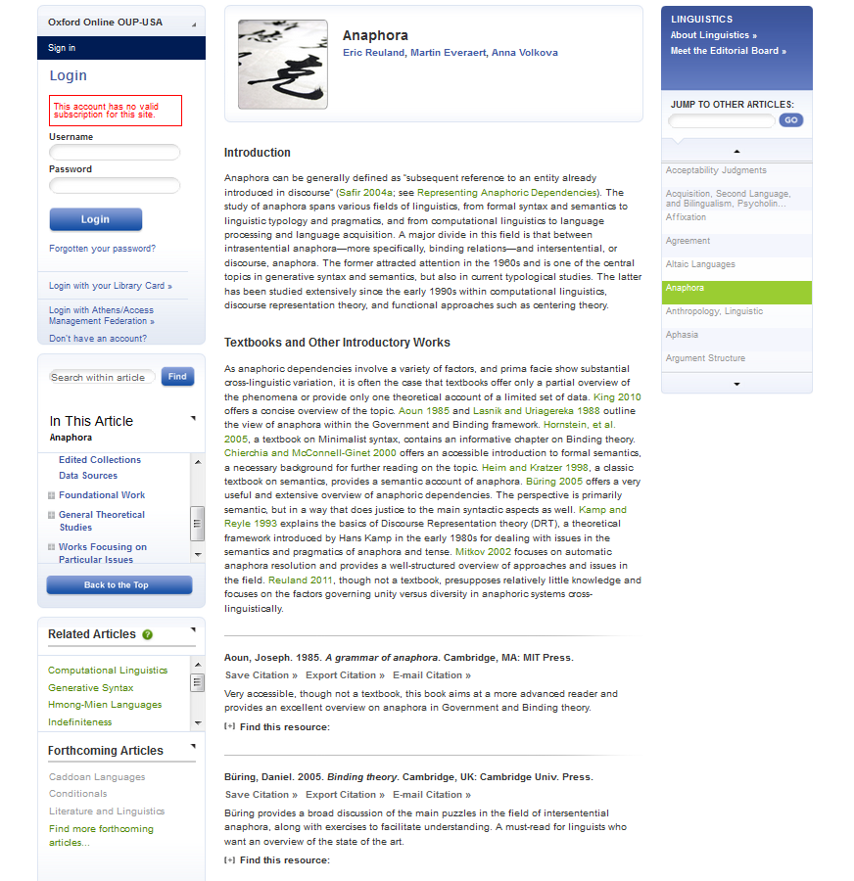
Headings concisely identify the type of resource or area of scholarship
Commentary provides context and recommendations to guide users through the cited sources
Citations provide selective list of best and most useful resources available
Annotations provide more information about each work and guidance on why it is important or useful

Slide 55
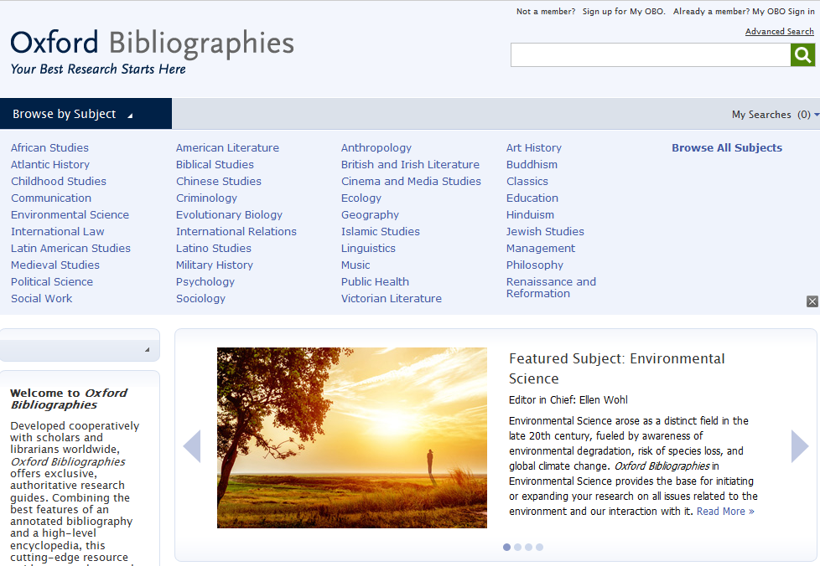
Каждая тема в Oxford Bibliographies объединяет обширную коллекцию статей, касающихся разделов той или иной дисциплины.
В результате получился невероятно мощный новый ресурс, разработанный, чтобы послужить исследователям путеводной нитью в ситуации информационной перегрузки.
Oxford Bibliographies разработан совместно с учёными и библиотекарями из разных стран и содержит эксклюзивные, авторитетные пособия для исследований.

Slide 56

Research Encyclopedias

Slide 57
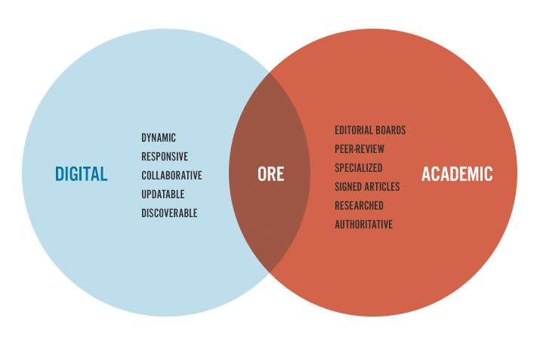
Oxford Research Encyclopedias
Continuously updated encyclopedias in 20 disciplines
Deliver in-depth interpretative overviews
Written and vetted by scholars for scholars and students
Map the entirety of a field of inquiry; evolve as the field evolves
Direct research journeys to other relevant trusted content

Slide 58
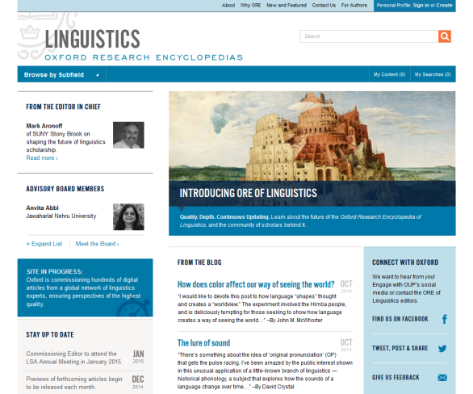
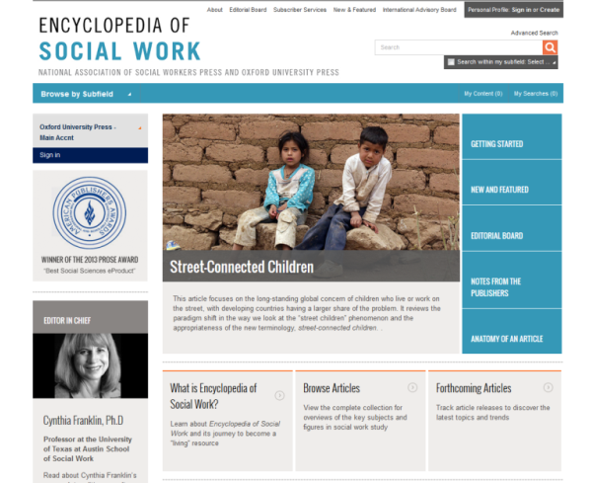
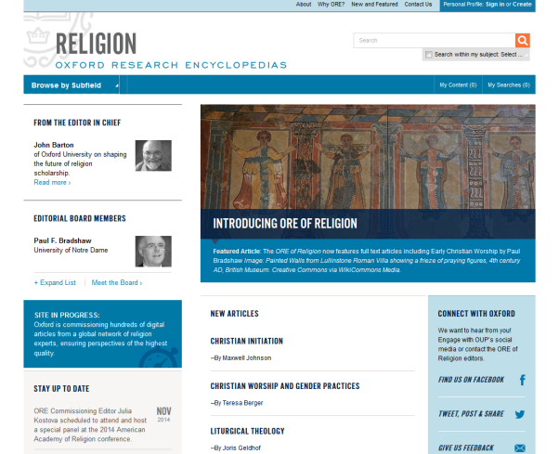
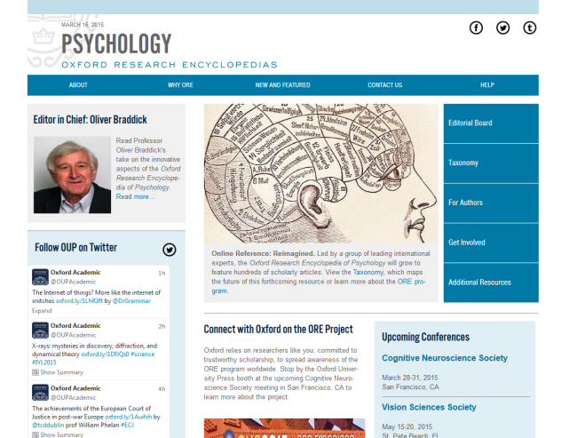
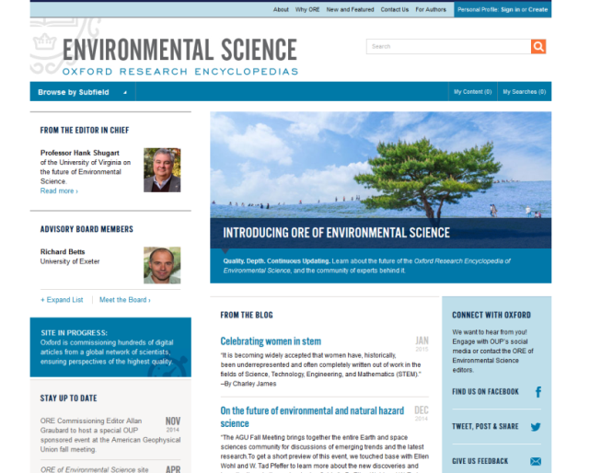
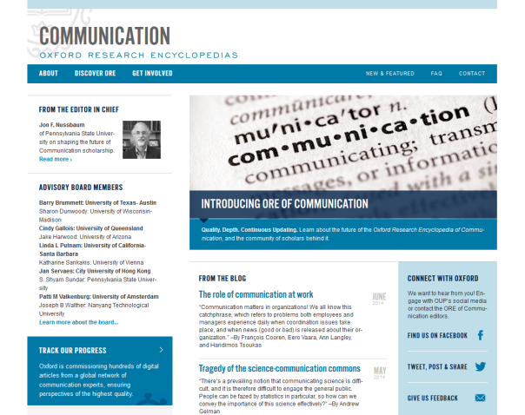
Disciplines Covered

Slide 59
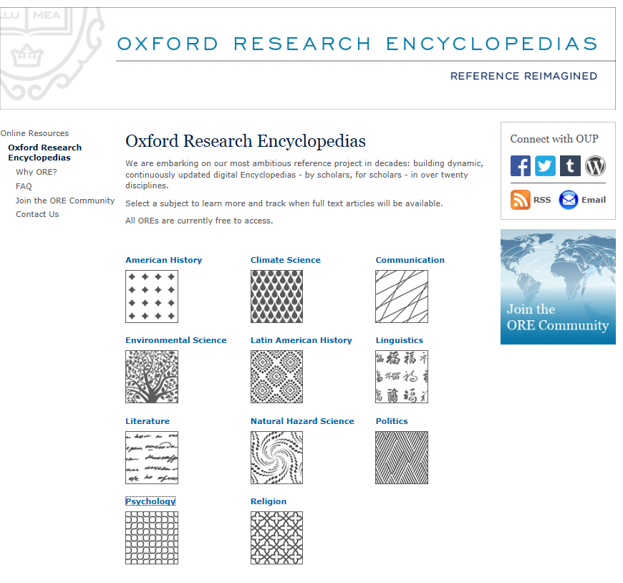

Oxford Research Encyclopaedias
Explore the content

Slide 60
Each resource provides a vital step on the research journey, from quick fact checking, to reviewing the literature in a field, to keeping up to date with the latest research.
Where do OUP Resources Fit in your Research Journey?
Subject Specific Resources
Notes:
The following slides show how each resource fits into the research journey. Each resource provides a vital step on the research journey, from quick fact checking, to reviewing the literature in a field, to keeping up to date with the latest research.

Slide 61
How we Can Help at
Oxford University Press

Slide 62

What is the AMA Manual of Style?
A must-have guide for anyone involved in medical or scientific publishing
An essential, one-stop resource providing quick access to authoritative information.
Everything you need to produce well-organized and clear manuscripts

Slide 63


Slide 64


Slide 65

M
AMA Manual of Style

Slide 66

EXCEPTIONAL ONLINE LEARNING
THROUGH GLOBAL COLLABORATION

Slide 67
EPIGEUM
The leading global provider of online training courses designed to help universities and colleges transform their:
  teaching
  research
  studying
  leadership and management
Courses designed for teachers, researchers, and students
Courses are developed by way of collaboration and then shared by subscription

Slide 68
WHY EPIGEUM ONLINE TRAINING COURSES?
Online training from world experts helps universities transform their teaching, learning, research and management
Over 260 universities worldwide
Spin-out from Imperial College London

Slide 69
Facts
Epigeum in numbers
Founded in 2005
78 courses
Used by 260 universities
In 27 countries
And 36% of the top 100 global universities
Including 95% of the UK Russell Group universities

Slide 70

Our courses are used by universities worldwide
Notes:
70

Slide 71
WHAT WE DO
Publish online training to the highest pedagogical standards
Universities identify training needs
Epigeum steers development group
Authors are world experts
Extensive video case studies and simulations

Slide 72


Slide 73

Research Skills Master Programme
Getting published in the arts
Getting published in the sciences

Slide 74

Research Skills & the Vitae Researcher Development Framework
Research Skills & the Vitae Researcher Development Framework

Slide 75

OUR COURSES WORK!
“We chose Epigeum courses because their online training programmes are better integrated and more creative than other providers’ courses.”
“We know that the course programme was rigorously designed and uses e-Assessment to check the material is understood.”
“We have reduced the number of workshops per quarter from 5 to 2”
Carol Cornelius, Research Support Associate, University of Oxford

Slide 76

Any Questions…
Marcin Dembowski
marcin.dembowski@oup.com

